Slide 1
Meeting Week 5
Last week summary
Feedback ASMPT
  Feedforward inversion
  FP-LPV scheduling
Research Plan
  Background
  Research questions
Outline ToDo next week

Slide 2
Last week summary
Specific decoupling used
  Associated parameters for decoupled FP model
Simulation Jan
  Adapt to MIMO (two lines of code)
  Adapt to LPV
Experiment design – Alternatives to OMNIPUS
  Will not be discussed at the moment

Slide 3
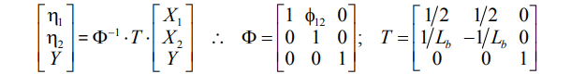
ASMPT Specifications - Decoupling
FP model decoupling
  Both coupled and decoupled FP model are available.
  Modal transformation decoupling:
  The physical motor positions X1, X2 are transformed into two (approximately) independent modal coordinates:
    η1: translation/synchronous motion of the cross-arm
    η2: twist/rotational mode of the cross-arm
The decoupled FP model can be used in the feedforward. The feedback cannot be changed due to firmware constraints, so we assume the existing feedback bandwidth is sufficient
(39)
“The feedforward control starts from the reference positions, velocities, and accelerations X1 ref, X2 ref, and Yref. These references are transformed into the equivalent decoupling basis references η1 ref, η2 ref and Yref, using (39)”
Notes:
modal transformation matrix (Φ−1)
purpose is to take the real-world, coupled physical coordinates of the gantry stage and mathematically transform them into a "decoupling basis“
Input vector (X1​, X2​, Y): These are the standard, measured position references for the physical actuators. X1​ and X2​ are the two parallel motors carrying the cross-arm, and Y is the motor carrying the payload
Row 1: Translation Equation (η1​=1/2​X1​+1/2​X2​)What to explain: By averaging the position of the two parallel actuators (X1​ and X2​), this equation calculates the exact center point of the cross-arm
Row 2: The Rotation Equation (η2​=1/Lb1​X1​−1/Lb​​X2​)What to explain: This equation calculates the difference in position between the two parallel actuators and divides it by Lb​ (the length of the moving cross-arm)
Physical meaning: Dividing the arc length (the difference in X) by the radius (Lb​) calculates the yaw angle (Θ). This isolates the pure rotation or twisting of the cross-arm about its own center of mass
Row 3: The Payload Equation (Y=Y)What to explain: The coordinate for the payload translation simply equals itself; the matrix multiplies it by 1 and ignores X1​ and X2​
Y does not need a new modal coordinate because it has already been "pre-decoupled“; feedforward anticipation.

Slide 4
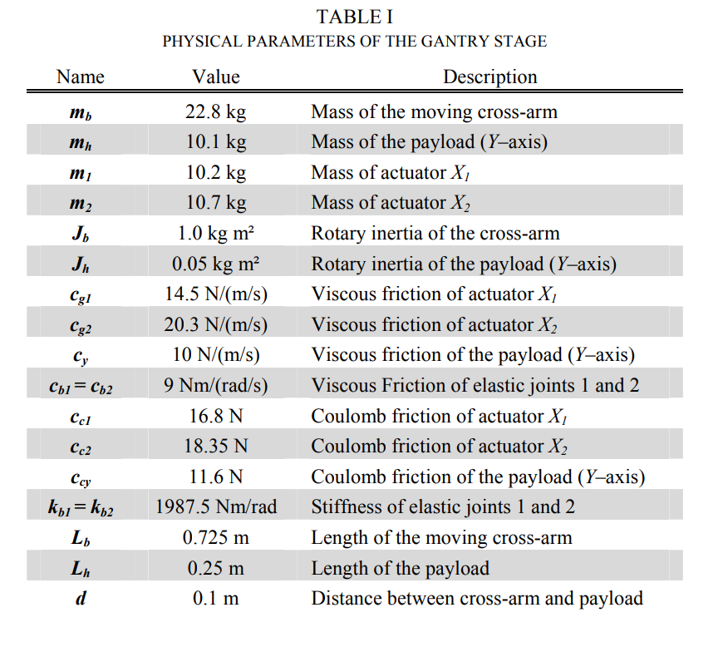
FP model
Entire decoupled FP model can be explained with parameters in table 1.
Experiments for parameters:
  Payload (Y-axis): To isolate the payload's parameters, the parallel actuators (X1​ and X2​) are physically blocked to prevent the cross-arm from rotating
  Synchronous Translation (X-axis):To identify the parameters of the main actuators, X1​ and X2​ are moved in perfect synchronization
  Rotation (Θ): To determine the parameters of the flexible joints and the cross-arm's rotary dynamics, the cross-arm is intentionally rotated
Notes:
“Recommended to repeat these experiments, seemed very doable”- ASMPT

Slide 5
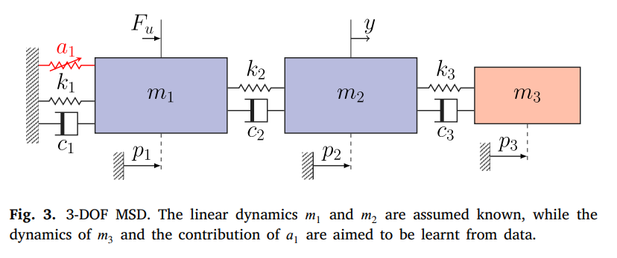
Simulation – Setup Jan
Need to adjust simulation section to incorporate LPV and MIMO methods into current simulation structure.
Mass Spring Damper system: dynamics of the third (red) mass block and a nonlinear cubic spring (a1) attached to the known modeled system.
Baseline Model: The code assumes we only have an imperfect, simplified physical model: linear 2-DOF system that only takes the first two masses into account

Slide 6
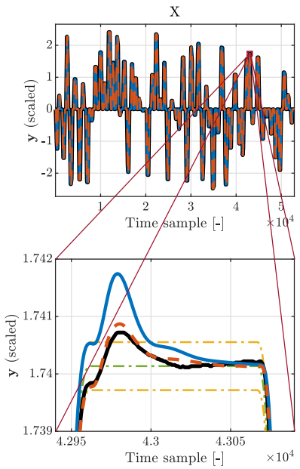
Feedback ASMPT
Feedforward not but only plant modeling
Feedforward inversion disconnect with original project description
Goal is not feedforward that will actively try to reduce settling error bound
  Instead create an accurate plant model. Can still focus on settling error, but not actively compensate
    Priorities for identifiability: cross-coupling
      Coupling not specifically non-linearities also hard to model linearities
Measured system – black
FP model – blue
EA model – red
Reference profile – green
Error bounds – yellow

Slide 7
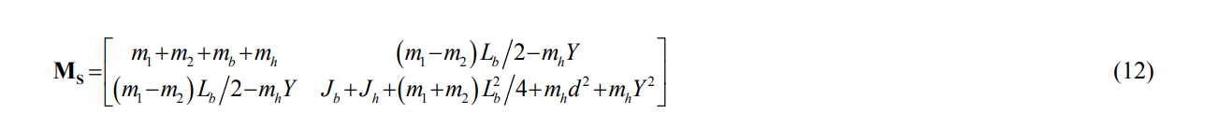
Feedback ASMPT
FP-LPV
LPV: Mass matrix M depends on Y-position
Currently incorporated into the research questions
Convert to state-space
Formulas from same paper as decoupling
Notes:
Initially didn’t want to include
If you have good nominal parameters: Formalize as state-space A(Y), B(Y)
Discretize
Validate on ASMPT system
→ Mostly analytical work + validation
If nominal parameters aren't accurate enough: Identify M₀, M₁, C, K from operational data
This requires LPV grey-box identification
→ Data-driven identification work
State space
Qs and qs dot for discrete state space LPV model
Need to invert Ms matrix for this, that’s where the problem start. If its non-singular in any position. If its singular need to treat as discrete time system. Analyze Ms matrix, whether its invertible.
What is q position. Know all the variables here, how this models come together.
Y and q different?
Y 2 or 1 dimension presentation of the mass/payload
Baseline model set of equations
Setup on where we can do measurements
Cant yet do augmentation from Jan because don’t have data from the system
So for now try to use simulation from Jan MSD for FP gantry model
Jan’s code is full nonlinear maybe efficient to do with LPV, adapt Jan’s code or use Roel’s code
Can stay in fairly nicely lpv framework, because its mainly cross-coupling. Because Jan is in full nonlinear. Setting up a small simulaton example.
Descriptor formulation for LPV. Ms is not always invertible, could already be a good identificication. Already has solutions for that.

Slide 8
Research Plan - Overview
  1. Background and already obtained results in the topic
  2. Literature survey
  3. Research questions
  4. AI&ES relevance
  5. Research methods
  6. Expected outcomes of the project
  7. Time planning phase 2

Slide 9
Research Plan - Background
Industrial Context & Requirements
Dual-Gantry System Challenges
Current Industrial Practice (ASMPT Baseline)
Grey-Box justification
Grey-Box Identifiability Problem
Solution Framework / Research Gap:
  Extend FP baseline to FP-LPV
  LPV-LFR + Orthogonality Regularization

Slide 10
Industrial Context & Requirements
Application: Semiconductor chip bonding for advanced packaging
Performance metric: Settling time drives throughput
Need: Accurate plant models for control design; digital twin

Slide 11
Dual-Gantry System Challenges
Configuration: Two parallel actuators support common crossbeam
Rigid-body dynamics: Decompose to modal coordinates
Identified Primary limitation: Position-dependent coupling

Slide 12
Current Industrial Practice (ASMPT Baseline)
Current feedforward implementation uses multiple FRF measurements → finds the optimum
The dual gantry system from ETEL already uses position dependent feedforward
Notes:
acceleration/massa feedforward

Slide 13
Grey-Box justification
Approach | Strengths | Limitations
White-box (FEM) | Physical interpretability, extrapolation | Hundreds of parameters, not identifiable
Black-box (NN/GP) | Captures all training dynamics | No interpretability, poor extrapolation
Grey-box | Physics baseline + learned residuals | Identifiability problem

Slide 14
Grey-Box Identifiability Problem
Parameter compensation: Learned component absorbs physics dynamics
Consequence: Physics parameters drift to non-physical values
Lost benefits:
  Physical interpretability (parameters lose meaning)
  Negation problem (orthogonality solution)
Notes:
LPV framework identifyibilaty important
Baseline model augment it

Slide 15
Solution Framework / Research Gap
Adapt FP to work for LPV
Adapt LFR to dual-gantry setup
Adapt LFR to work with LPV
Adapt LPV-LFR to work with orthogonality
Notes:
Straight up jump to LPV-LFR given the tools. Is more logical step to go straight instead of just LFR
First step, translate LPV-FP translate into state space with the invertability steps Rolands described. Link it to the LPV structure we described.
Later step we can look wether we use orthogonality or use another method to preserve interprability.
Do this loop twice.
Once for simulation setup
Once for real system, choice of experiment design. Combine local FRFs with global measurements. Extra aspect that comes in to play there.

Slide 16
Research Plan – Research questions
Main RQ:
Can orthogonality-constrained LPV-LFR augmentation improve prediction accuracy of flexible cross-coupling and position-dependent dynamics during settling while preserving parameter identifiability compared to rigid-body baselines on dual-gantry hardware?
Dragan mentioned main part we want to identify is coupling (not friction for example)
Notes:
This is already very specific.
Include everything I want to include in the solution
How to obtain an interpretable model of the dual-gantry system. Can add cross-coupling in the question somewhere.
Orthogonality possible answer same for lpv etc.

Slide 17
Research Plan – Research questions
RQ1: LPV Parameter Scheduling
Does the LPV physics baseline with position-dependent scheduling improve prediction accuracy during settling compared to position-independent (LTI) modeling?
Notes:
Just subdivide the main rq into the sub rqs
Evaluate accuracy baseline model that is avalailbe physics lpv model compare it to an LTI alternative.

Slide 18
Research Plan – Research questions
RQ2: Parallel LFR Augmentation Structure
What parallel LFR augmentation structure is required to capture flexible cross-coupling and improve settling prediction accuracy beyond the rigid-body baseline?
Notes:
Which exact augmentation structure we will address.
What type of LPV-LFR structure we aim to use.
Master thesis does not require subquestions
Just state what you want to answer main rq with these

Slide 19
Research Plan – Research questions
RQ3: Orthogonality-Constrained LPV-LFR
Does orthogonality-constrained LPV-LFR augmentation maintain prediction accuracy during settling while improving parameter identifiability compared to unconstrained augmentation?
Notes:
How to interpret the augmentation and how can we ensure interpretability during identification.
Possible direction
Regularization or orthogonality.

Slide 20
Research Plan – Research questions
RQ4: Industrial Hardware Generalization
Does the orthogonality-constrained LPV-LFR model maintain prediction accuracy during settling across (i) untrained operating points within the operational range and (ii) untrained motion profiles within nominal specifications on physical hardware?
Notes:
Model validation, not a rq.
Unseen data, which is in the same range as training data

Slide 21
Outline next week
Deliver final research plan

